Slide 1
Smart Results Viewer.
A Web Application for Viewing and Analyzing Results.
Created by Doris Uchechukwu Anakwuba.

Slide 2
Project Overview.
Smart Results Viewer is a web application designed to help users easily view, understand, and analyze results.
It transforms raw data into a clean and interactive interface, making performance insights clearer and more accessible.

Slide 3
Problem Statement.
Raw result data can be difficult to understand
Lack of visual representation makes analysis harder
Users need a simple and responsive interface

Slide 4
Solution.
This application provides:
A structured way to display results
Visual charts for better understanding
A responsive and user-friendly interface

Slide 5
Key Features.
📊 Interactive charts for data visualization
📋 Clear and organized results display
📱 Fully responsive design
⚡ Fast and efficient performance

Slide 6
Technologies Used.
React
Vite
Tailwind CSS
Chart.js
Axios

Slide 7
How It Works.
User opens the application
Data is fetched and processed
Results are displayed clearly
Charts visualize performance data

Slide 8
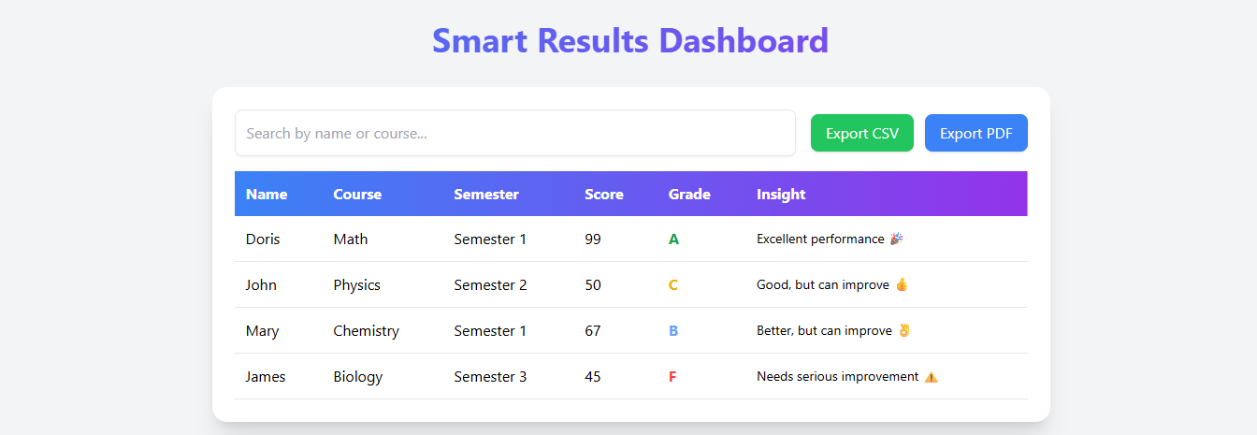
Screenshot of Dashboard.

Slide 9
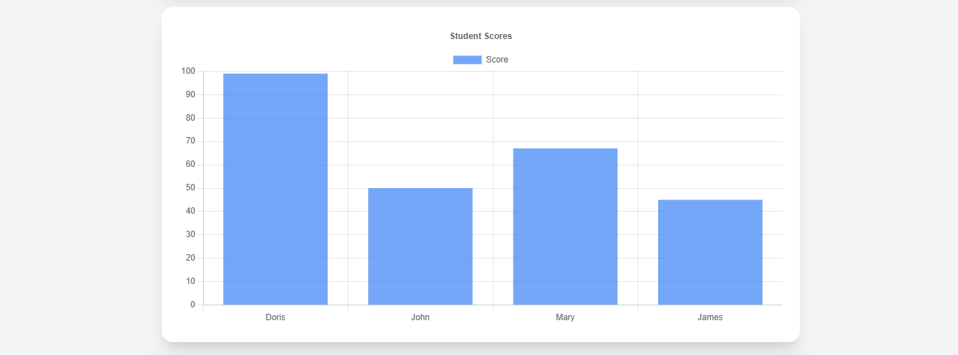
Screenshot of Score Chart.

Slide 10
Challenges Faced.
Managing data structure
Making the UI responsive
Integrating charts properly

Slide 11
What I Learned.
Building responsive React apps
Working with APIs and data
Data visualization using Chart.js
Project structuring and deployment

Slide 12
Conclusion.
Smart Results Viewer successfully improves how users interact with and understand result data through simplicity and visualization.

Slide 13
Thank You!
Thank you for taking the time to go through my slides.

